Slide 1

Maternal Health Check
Usama Bin Nasar

Slide 2
Source: W.H.O
Maternal Health
Maternal health refers to the health of women during pregnancy, childbirth and the postnatal period.
Maternal Mortality
About 287,000 women died during and following pregnancy and childbirth in 2020.
Common Causes
Blood loss, infection, high blood pressure, unsafe abortion, anemia, malaria and heart disease.
Most impacted Regions
Sub-Saharan Africa and Southern Asia share the greatest burden of maternal deaths, 86% of the global total in 2017.

Slide 3
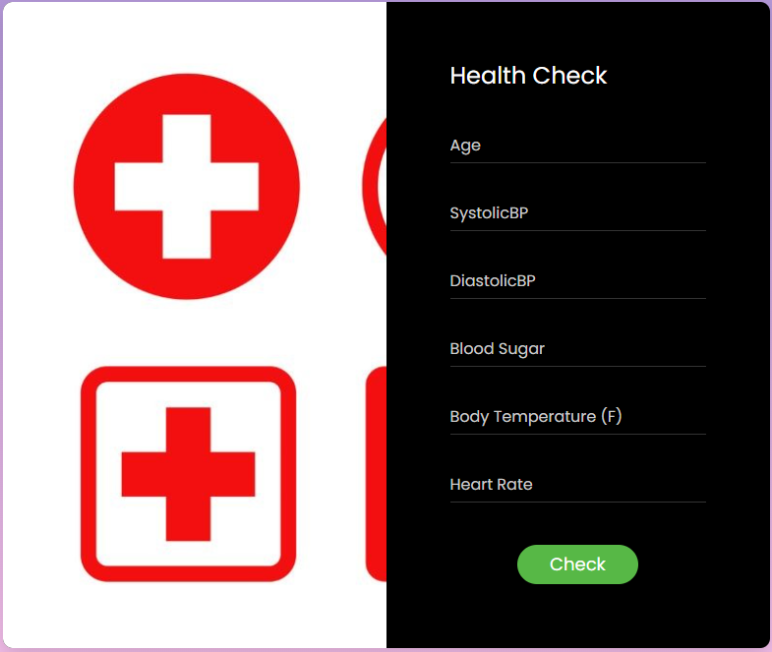
project OVERVIEW
GUI
Accepts user input values
Function
Uses Machine Learning model to calculate the health of the user
Model
Random Forest is used to train and test the data
Tools
FLASK, JavaScript, Leaflet.JS, Plotly.JS, PostgreSQL, JSON, HTML, CSS, BOOTSTRAP

Slide 4






Flow Diagram
Flask

Slide 5
Data Sources
Machine learning dataset
https://www.kaggle.com/datasets/csafrit2/maternal-health-risk-data
This dataset is directly from healthcare IoT devices. The author's source is from Daffodil International University. They are specified to be IoT devices in remote areas.
Countries Maternal Mortality dataset
WHO, UNICEF, UNFPA, World Bank Group and UNPD (MMEIG) - February 2023

Slide 6
THANK YOU
Usama Bin Nasar
ubnas1@outlook.com
linkedin.com/in/usama-bin-nasar/

